Slide 1


Python – Exception Handling

Slide 2
Highlights!
Error Vs Exceptions
Try and Except Statements
Built-in Exceptions
Multiple catch
Else
Finally
Assert
Raise

Slide 3
Error and Exceptions
Two types of them:
Syntax errors: Syntax error occurs when the programmer did not follow the predefined syntax rules of a particular entity in the code. If the compiler finds a syntax mistake, it terminates the program and raises the error. We need to fix it.
Logical errors: Logical errors are the mistakes the programmer makes in the logic of the code. These are not raised; instead, the mistake is to be understood when the code does not meet the purpose or problem. These are to be searched, found, and edited by the programmer and are hard to find.

Slide 4
Now coming to the concept of exceptions:
An exception is an unexpected error raised at the time of execution (not at compilation).
These are not dangerous to the code; there are methods in python to handle these exceptions.
Example: If we try to divide a number by 0, the compiler won't detect it as the syntax is correct.
At the time of execution, the exception will be raised.
1. a = 3
2. print(a/0)
Output:
Traceback (most recent call last): File "D:\Programs\python\exception_ex.py", line 2, in print(a/0) ZeroDivisionError: division by zero
The last line of the message indicates the type of exception raised which is ”ZeroDivisionError”.
There are a lot of exceptions built-in in python.

Slide 5
Try and Except Statement –
Catching Exceptions
The "Exception" is the base class for all the exceptions. Exceptions usually occur unexpectedly and disturb the execution of the whole code. Hence, we catch these exceptions and handle them for the execution to go smoothly.
Steps:
The part of the code on which the programmer doubts that it may cause an exception is kept in the “try” block.
If the doubt comes true and an exception is found, we write the handling code inside the "except" block.
Code we write inside the "except" block replaces the exception/error message that usually gets printed when the exception is found.
In this way, the execution flow is not disturbed, and the exception is handled.

Slide 6
try:
a = 3
print (a/0)
except:
print ("An error occurred")
In the output, instead of the exception, the print statement in the "except" block
will be printed:
“An error occurred”

Slide 7
Another Example
try:
array = [2,3,5,6]
print (array)
for i in range (0,5):
print ("The element in", i ,"index is:", array[i])
except:
print ("Tried to access an out of bound index-check it")
Output
[2, 3, 5, 6]
The element in 0 indexes is: 2
The element in 1 index is: 3
The element in 2 index is: 5
The element in 3 index is: 6
Tried to access an out of bound index-check it

Slide 8
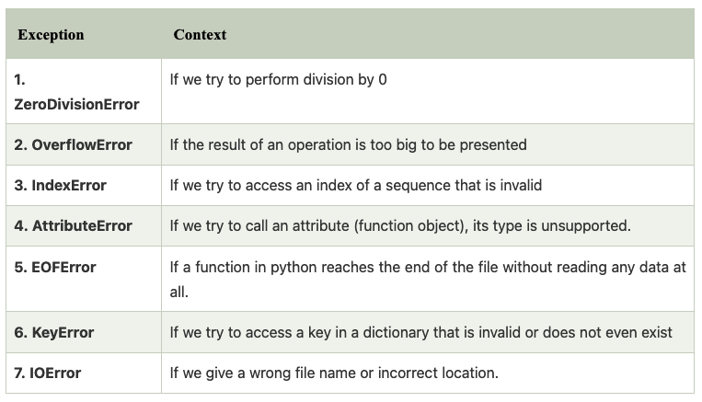
Common built-in exceptions

Slide 9
Multiple catch statements
try:
array = [2,3,5,6,7]
print(array)
for i in range(0,5):
print("The element in" , i , "index is:", array[i])
for i in reversed(range(-1,3)):
print(array[0]/0)
except IndexError:
print("Tried to access an out of bound index-check it")
except ZeroDivisionError:
print("Oops! Division by zero")
Output:
# Zero division error
[2, 3, 5, 6, 7]
Oops! Division by zero
#Index error
[2, 3, 5, 6]
The element in 0 index is: 2
The element in 1 index is: 3
The element in 2 index is: 5
The element in 3 index is: 6
Tried to access an out of bound index-check it

Slide 10
Try with else
According to the syntax, the else block must be placed after all the "except" blocks.
If the code in the try block is successfully executed without raising any exceptions, else block will be executed.
num = int (input ("Enter the numerator: "))
den = int (input ("Enter the denominator: "))
try:
res = num/den
except ZeroDivisionError:
print ("The denominator cannot be zero")
else:
print ("The result of the division:", res)
#Sample output-1-No exception rose
Enter the numerator: 3
Enter the denominator: 4
The result of the division: 0.75
#Sample output-2-Exception rose
Enter the numerator: 3
Enter the denominator: 0
The denominator cannot be zero

Slide 11
"finally" keyword
“finally" is a keyword in python that we can use in exception handling by placing
it after the else block if any. The code in the finally block is executed irrespective of
any other blocks.
try:
array = [2,3,5,6]
print (array)
for i in range (0,5):
print ("The element in", i ,"index is:", array[i])
except:
print ("Tried to access an out of bound index-check it")
else:
print("No exceptions. Well done")
finally:
print("You are now looking at the code in the finally block")
Output
[2, 3, 5, 6]
The element in 0 index is: 2
The element in 1 index is: 3
The element in 2 index is: 5
The element in 3 index is: 6
Tried to access an out of bound
index-check it
You are now looking at the code
in the finally block

Slide 12
“Assert” Statement
Python uses ArgumentException, if the assertion fails, as the argument for the AssertionError.
1. # defining a function
2. def square_root( number ):
assert ( number > 0), "Give a positive integer"
return number**(1/2)
5. #Calling function and passing the values
6. print( square_root( 36 ) )
7. print( square_root( -36 ) )
Output
AssertionError: Give a positive integer

Slide 13
Raising our own exceptions
"raise" is a keyword in python, and by using a raise statement, we can raise our exceptions to stop the next statements from getting executed. "raise" statement without any arguments by its side is invalid and raises an error.
1. x = -1
2. if x < 0:
3. raise Exception("Sorry, no numbers below zero")
try:
raise
except ZeroDivisionError:
print ("Don't divide by zero-check it")
Output
Exception: Sorry, no numbers below zero
Output
RuntimeError: No active exception to reraise

